Slide 1
Analysis and Mitigation of Radiation Induced Errors In Modern Circuits
Dissertation Defense
Adam Watkins
Advisor: Spyros Tragoudas

Slide 2
Outline
Introduction
Robust Latch for Multiple Node Upsets
Analytical Approximation Model for Multiple Transients
Accurate Soft Error Simulation Using Partitioning
Conclusion

Slide 3
Introduction
This defense focuses on the effects of soft errors
Soft Error
Temporary error – induced by a radiation particle
Occurs when a particle strikes the sensitive volume of a transistor
Two types of soft error investigated
Single Event Transient (SET) – a temporary voltage pulse
Single Event Upset (SEU) – SET is propagated to latch input or value is flipped in latch
A particle striking a transistor does not guarantee an error
Decrease in feature size has increased the likelihood of error

Slide 4
Introduction
3 novel mitigation and estimation approaches proposed
Chapter 1
A soft error tolerant latch suitable for clock gating
Capable of tolerating double node upsets (DNUs)
Chapter 2
Accurate pulse shape approximation method
Considers multiple pulses on the gate input
Chapter 3
FAST_MET simulation tool - calculates the soft error rate (SER)
Uses partitioning, Boolean functions and accurate pulse shape approximation

Slide 5
Outline
Introduction
Robust Latch for Multiple Node Upsets
Analytical Approximation Model for Multiple Transients
Accurate Soft Error Simulation Using Partitioning
Conclusion

Slide 6
Robust Latch for Multiple Node Upsets
Proposed design can tolerate DNUs
Existing designs can tolerate single node upsets (SNUs) and DNUs
Many are not suited for clock gating
Use a weak keeper on a c-element
Proposed design recovers all nodes after error
Is the most efficient design for use in clock gating
Is DNU robust
No high impedance states after a DNU
C-element with a weak keeper on the output

Slide 7
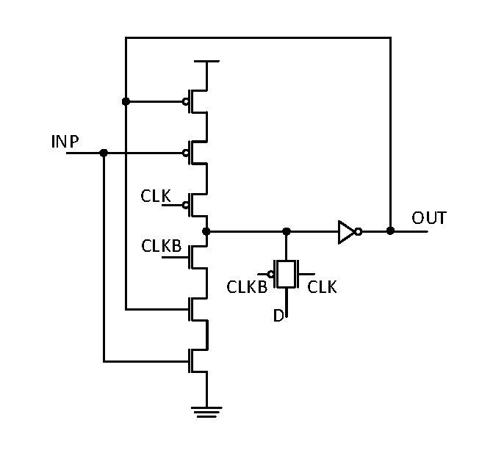
Proposed DNU Tolerant Latch
Proposed latch is based on 3 block latches connected to a c-element
The block based latch is not DNU resilient or robust
Block based latch
Basic data storage block

Slide 8
HRDNUT Latch
Block based latch is modified so no signal drives itself
Leads to the Highly Robust Double Node Upset Tolerant (HRDNUT) latch
HRDNUT is DNU robust since all nodes recover to their correct state after a DNU
HRDNUT Latch

Slide 9
HRDNUT Normal Operation
Data loop in the HRDNUT indicated in red
Transparent Mode
3 pass gates are activated
Data is loaded to nodes OUT, n1 and n2
This sets in inputs of C3, thus setting n3
C4, C5, C6 and C7 are set, thus setting the value
Hold Mode
The pass gates are deactivated
A loop is formed between C1, C2 and C3 holding the data (in red)

Slide 10
HRDNUT Operation During a DNU
Assume n2 and n3 will change values due to a DNU
Transient on n2 (in red)
Blocked by C4 since it is driven by OUT
Propagated to the NMOS on C5 and PMOS on C6
Transient on n3 (in blue)
Blocked at C2 since n4 does not change
Propagated to C6, could change the value on n6 if error goes to 0 (in green)
Error is blocked at C7 since n1 does not have a transient

Slide 11
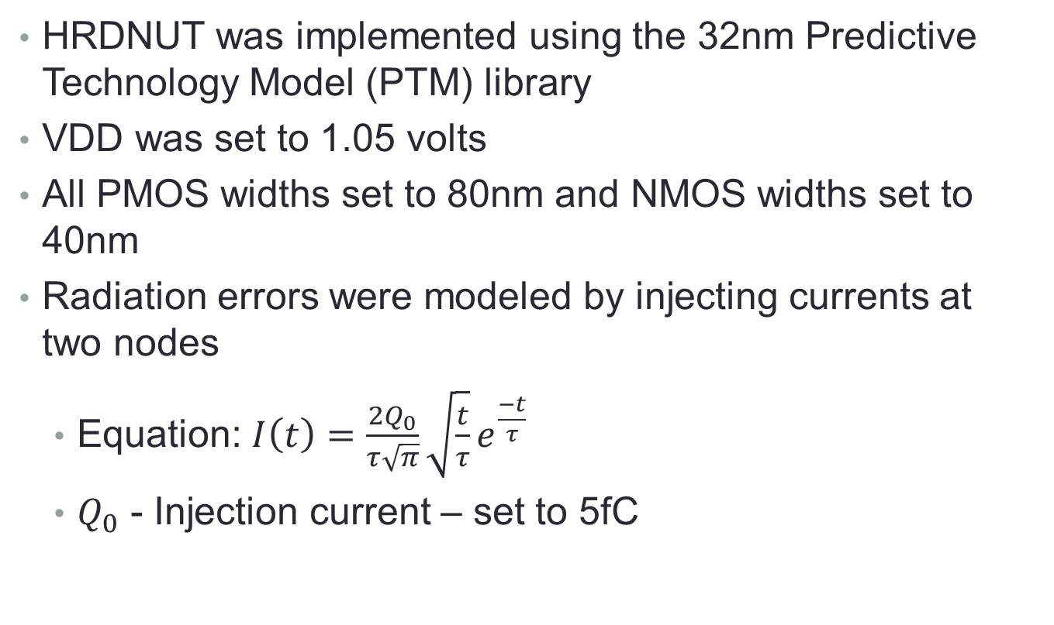
Simulation Results
HRDNUT was implemented using the 32nm Predictive Technology Model (PTM) library
VDD was set to 1.05 volts
All PMOS widths set to 80nm and NMOS widths set to 40nm
Radiation errors were modeled by injecting currents at two nodes
Equation: $I\left(t\right)=\frac{2Q_{0}}{τ\sqrt{π}}\sqrt{\frac{t}{τ}}e^{\frac{−t}{τ}}$
$Q_{0}$ - Injection current – set to 5fC

Slide 12
Simulation Results
Waveforms of two internal nodes with simultaneous SEUs
Waveforms of the CLK and Data signals
Waveforms of an internal node and the output with simultaneous SEUs

Slide 13
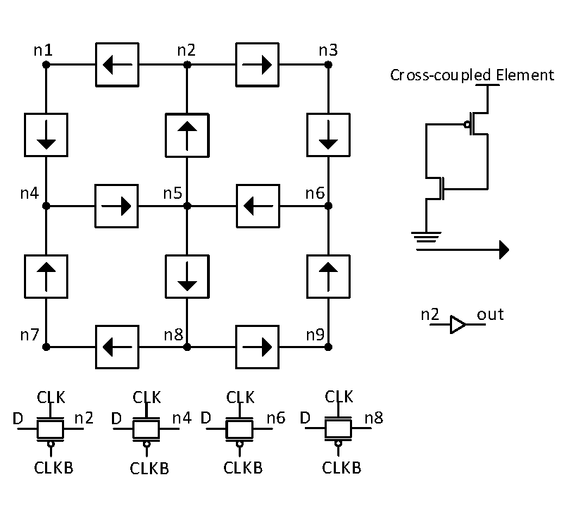
Existing DNU Robust Design
Existing DNU robust design is the DONUT latch
Uses 12 cross-coupled elements
The device recovers all nodes after a DNU – DNU robust
HRDNUT improves on the DONUT by offering lower power and delay
DONUT Latch [3]
[3] N. Eftaxiopoulos et al, Donut: A double node upset tolerant latch, 2015

Slide 14
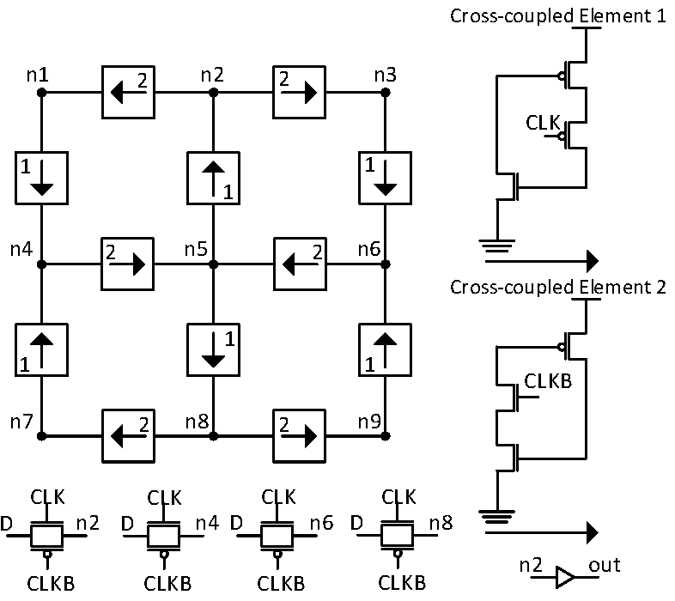
Modified DONUT Latch
Standard DONUT latch has relatively high power and delay
Was due to contention on data lines during the transparent mode
Transistors were added to put all data loading nodes to high impedance during the transparent mode
Saved power and decreased delay at a cost of area
Modified DONUT Latch

Slide 15
Comparison to Existing Designs
HRDNUT has been extensively compared to existing designs in power, area and delay
All designs implemented with the following
PMOS Width: 80nm
NMOS Width: 40nm
If a weak keeper is used the output c-element was sized
PMOS Width: 320nm
NMOS Width: 160nm
Area is represented as unit sized transistors (UST) which is the number of minimum width transistors (40nm)

Slide 16
Comparison to Existing Designs
Latch | DNU Immune | DNU Robust | Power (µW) | Delay (ps) | Area (UST)
DICE | No | No | 1.332 | 8.145 | 16
FERST | No | No | 3.178 | 31.648 | 60
HIPER | No | No | 1.292 | 2.221 | 27
DNCS | Yes | No | 4.948 | 22.486 | 61
HSMUF | Yes | No | 1.871 | 1.0626 | 51
HSMUF (Keeper) | Yes | No | 3.787 | 3.945 | 78
DONUT | Yes | Yes | 4.021 | 14.722 | 54
DONUT (Modified) | Yes | Yes | 2.760 | 8.421 | 72
HRDNUT | Yes | Yes | 2.450 | 2.310 | 66

Slide 17
Triple Node Upsets
Further scaling may lead to more multi-node upsets
A possible issue is the triple node upset (TNU)
Triple Node Upset – one or more particles causing 3 simultaneous transient pulses
A latch showing promise as TNU tolerant was designed
Has 11 nodes – 165 possible TNU cases
May also be TNU robust

Slide 19
Conclusion
Soft errors are a concern in circuit design
New circuit designs and simulation tools are required to handle increasing error rate
For the dissertation the following are proposed
A DNU tolerant latch suitable for clock gating
A simulation tool that calculates the SER using BDDs and an accurate electrical masking model
An accurate equivalent circuit model for determining the pulse shape

